Slide 1




Driver scheduling problem modelling
Ian Tung (2098865)

Slide 2
Contents of this template
You can delete this slide when you’re done editing the presentation
Fonts | To view this template correctly in PowerPoint, download and install the fonts we used
Used and alternative resources | An assortment of graphic resources that are suitable for use in this presentation
Thanks slide | You must keep it so that proper credits for our design are given
Colors | All the colors used in this presentation
Icons and infographic resources | These can be used in the template, and their size and color can be edited
Editable presentation theme | You can edit the master slides easily. For more info, click here
For more info: Slidesgo | Blog | FAQs
You can visit our sister projects: Freepik | Flaticon | Storyset | Wepik | Videvo

Slide 3
Table of contents
01
02
03
04
05
06
Introduction
Term Explanation
Basic Model
Model
Results & Findings
Questions

Slide 4

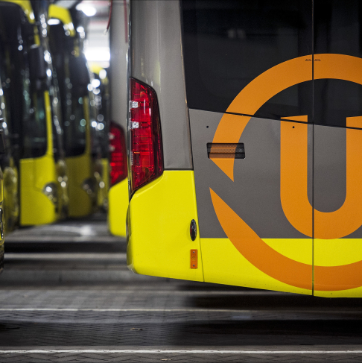
Introduction
1. What is Driver scheduling problem (DSP)?
Definition: Allocating vehicle shifts to drivers
Challenges: Numerous constraints & Combinatorial explosion
2. Current situation and pain points
Mostly uses the SPP or SCP models
Mathematical solution requires manual modification
Tractable vs. Valid
https://www.provincie-utrecht.nl/actueel/nieuws/nieuwe-makkelijke-tarieven-voor-het-utrechtse-openbaar-vervoer

Slide 5
Term Explanation
Block
Relief Point/
Opportunity
Piece of Work
A single vehicle's full itinerary from depot exit to return
Designated location and time where drivers can change
The indivisible period between two consecutive relief opportunities
Little Interruption
Stretch
Duty
Short paid gaps where the driver stays on the vehicle without driving
A consecutive driving period formed by multiple pieces of work
A driver’s full daily schedule, including driving, breaks, and travel

Slide 6

01
Introduction

Slide 7
Evaluation Criteria
Simplicity
Solution Quality
Applicability
Ease of understanding and operation
Level of schedule optimization
Real-world feasibility with minimal manual adjustment

Slide 8
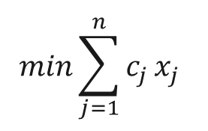
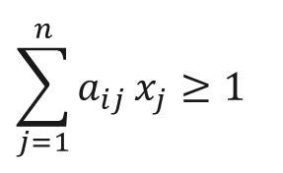
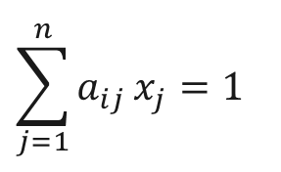
SPP/SCP Model
Set Partitioning (SPP)
$$min\sum_{j=1}^{n}{c_{j}}x_{j}$$
$$\sum_{j=1}^{n}{a_{ij}}x_{j}=1$$
Exactly One duty per piece of work.
Objective Function
Find the combination of duties that minimizes the total cost while covering all tasks
$$\sum_{j=1}^{n}{a_{ij}}x_{j}≥1$$
Set Covering (SCP)
At Least One duty per piece of work

Slide 9
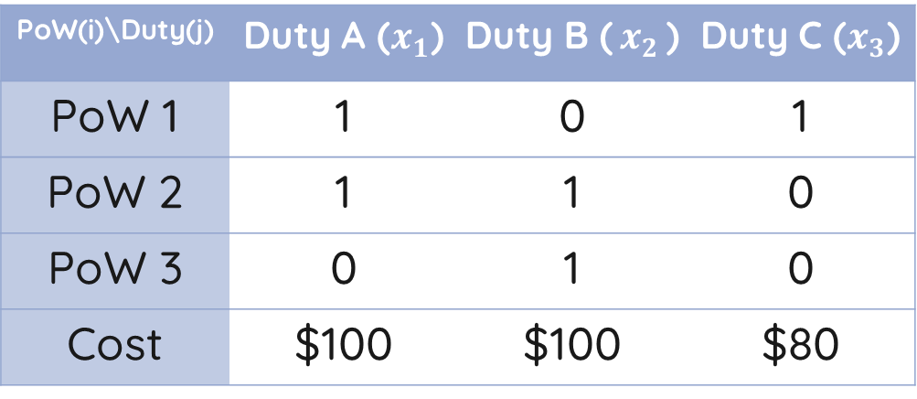
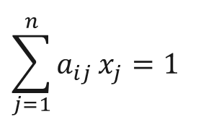
Model Matrix
PoW(i)\Duty(j) | Duty A ($x_{1}$) | Duty B ($x_{2}$) | Duty C ($x_{3}$)
PoW 1 | 1 | 0 | 1
PoW 2 | 1 | 1 | 0
PoW 3 | 0 | 1 | 0
Cost | $100 | $100 | $80
$$\sum_{j=1}^{n}{a_{ij}}x_{j}=1$$

Slide 10



Model
$$SCPNum_Maxc$$
$$SCPNum_Maxc_t$$
$$SCPNum_Maxc_t_Pscp$$

Slide 11
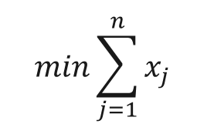
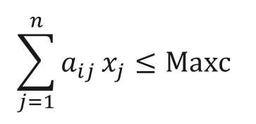
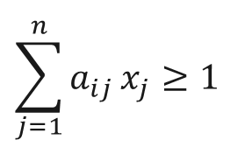

Model - $SCPNum_Maxc$
$$min\sum_{j=1}^{n}{x_{j}}$$
$$\sum_{j=1}^{n}{a_{ij}}x_{j}≥1$$
$$\sum_{j=1}^{n}{a_{ij}}x_{j}≤Maxc$$
Objective Function
Constraint Set
Constraint Set
Minimize the total number of duties (drivers)
At Least One duty per piece of work
No More than Maxc duty per piece of work

Slide 12
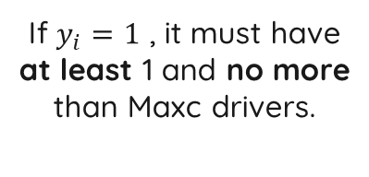
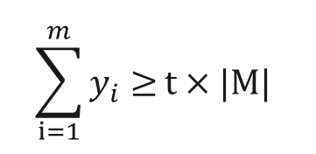
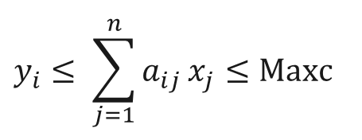

Model - $SCPNum_Maxc_t$
$$min\sum_{j=1}^{n}{x_{j}}$$
$$y_{i}≤ \sum_{j=1}^{n}{a_{ij}}x_{j}≤Maxc$$
$$\sum_{i=1}^{m}{y_{i}≥}t×|M|$$
Objective Function
Constraint Set
Constraint Set
Minimize the total number of duties (drivers)
If $y_{i}=1$ , it must have at least 1 and no more than Maxc drivers.
At least t% of all pieces of work must be covered.

Slide 13
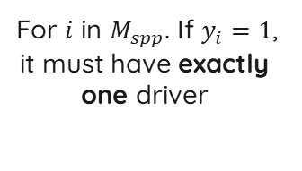
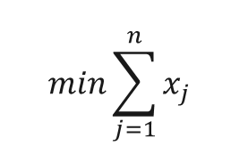
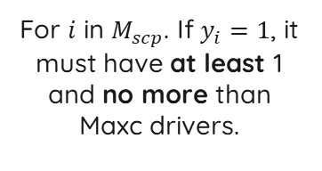
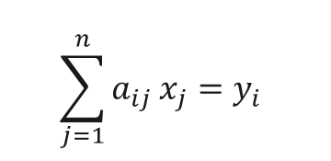
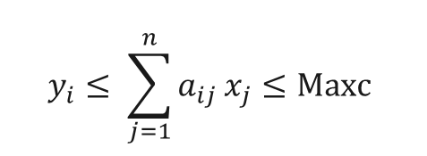

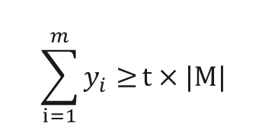
Model - $SCPNum_Maxc_t_Pscp$
$$min\sum_{j=1}^{n}{x_{j}}$$
$$y_{i}≤ \sum_{j=1}^{n}{a_{ij}}x_{j}≤Maxc$$
$$\sum_{j=1}^{n}{a_{ij}}x_{j}=y_{i}$$
$$\sum_{i=1}^{m}{y_{i}≥}t×|M|$$
Objective Function
Constraint Set
Constraint Set
Constraint Set
Minimize the total number of duties (drivers)
For $i$ in $M_{scp}$. If $y_{i}=1$, it must have at least 1 and no more than Maxc drivers.
For $i$ in $M_{spp}$. If $y_{i}=1$, it must have exactly one driver
At least t% of all pieces of work must be covered.

Slide 14
Key Experimental Findings
Controlling Overcrowding
The Flexibility of "Gaps"

Slide 15
Tailored Solutions: Urban vs. Suburban
Urban Instances
Suburban Instances

Slide 16
Conclusions: Why the New Models Succeed?
Applicability
Efficiency
Simplicity
Flexibility

Slide 17
Thanks!
Please keep this slide for attribution

Slide 18
333,000
9h 55m 23s
386,000 km
Users bought our product
Estimated delivery time per unit
Avg. distance travelled by logistics team

Slide 19
4,498,300,000
Number of users analyzed in our market research

Slide 20

Revenue by quarter
Q1
Q3
Q2
Q4
January - March
July - September
April - June
October - December
Follow the link in the graph to modify its data and then paste the new one here. For more info, click here

Slide 21
Competition comparison
 | Features | Value | Pricing | Trial | Competence | Share
Company A | Fuel economy | Special offers | $23,000 | No | Low | 8%
Company B | Design | Reliability | $27,000 | No | Low | 5%
Company C | Performance | Repairs | $30,000 | Yes | High | 20%
Company D | Safety features | Marketing | $24,000 | No | High | 22%
Company E | Technology | Customers | $32,000 | Yes | Low | 10%
Company F | Comfort | Best prices | $15,000 | Yes | High | 30%
Company G | Customization | Brand name | $45,000 | No | Low | 5%

Slide 22

Product infographic
Visuals
Features
Showcase the design of your product
What makes you product unique?
Price
Users
Share the cost and price with investors
Speak about the target audience
Availability
Updates
When is the product expected to be ready?
Do you plan on updating it?

Slide 23
Timeline of your presentation
01
02
03
04
Provide a brief overview of the pitch deck's content
Engage the audience with a compelling introduction
Identify the customer's pain points
and challenges
Describe how your product or service can solve the problem
05
06
07
08
Highlight the unique value proposition and benefits of your specific solution
Analyze the target market size, growth potential, and competition briefly
Explain your financial needs and briefly outline your
funding allocation
End with a clear and concise call to action

Slide 24
Organizational chart
John Doe
CEO
Jane Smith
Department Head
Mark Willson
Department Head
Emma Miller
Manager
Richard Taylor
Manager
Sarah Williams
Manager
Steven Ander
Manager
Brian Clark
Employee
Michelle García
Employee
James Scott
Employee
William Young
Employee
Alan Turner
Employee

Slide 25
Market size overview
$100M
Outer circle
Include the total size of the market, which represents the entire potential customer base for the product or service
$20M
Middle circle
Identify the target market for the product or service, which may be a subset of the total market. This could be based on factors such as demographics, geography, or specific needs
$5M
Inner circle
Indicate the current market size, which represents the portion of the target market that the company has successfully captured

Slide 26
Roadmap infographic
Initiative | Objective | Jan | Feb | Mar | Apr | May | Jun | Jul | Aug | Sep | Oct | Nov | Dec
Understanding | Analyze and understand the needs of your target audience
Conduct research | Research existing products in the industry and analyze how successful they are
Brainstorm ideas | Generate ideas based on user feedback and research findings
Develop a prototype | Create a basic version of the product to show investors
Test for usability | Put the prototype through rigorous testing processes to ensure that it meets user requirements
Analyze feedback | Analyze feedback

Slide 27
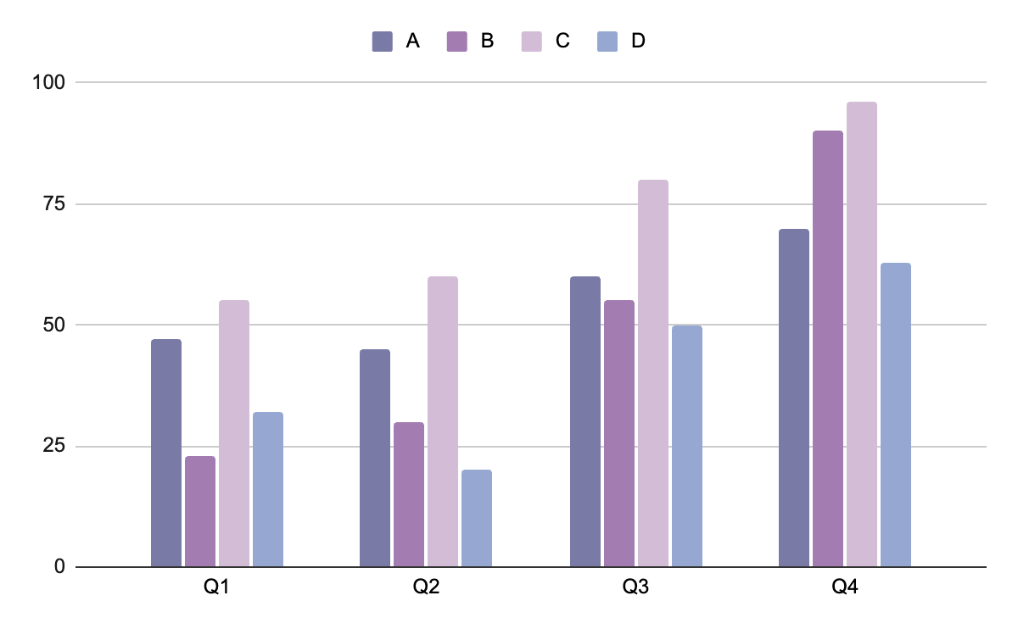
KPI dashboard
Product | Units | Revenue | Returns
Item 1 | 500 | 2,000,000 | 40
Item 2 | 1,000 | 50,750 | 10
Item 3 | 250 | 1,500,000 | 300
Item 4 | 500 | 2,000,000 | 40
Item 5 | 1,000 | 50,750 | 10
Item 6 | 250 | 1,500,000 | 300
Item 7 | 500 | 2,000,000 | 40
Item 8 | 1,000 | 50,750 | 10
$4,000,000
$100,000
$5,000
Revenue
General costs
Benefit
Follow the link in the graph to modify its data and then paste the new one here. For more info, click here

Slide 28
Alternative resources
Here’s an assortment of alternative resources whose style fits the one of this template:
Abstract background of molecules

Slide 29
Resources
Did you like the resources on this template? Get them for free at our other websites:
Vectors
Futuristic technology concept gradient background
Futuristic science lab background
Photos
Black man giving presentation on a meeting
Medium shot queer model working with laptop

Slide 30
Instructions for use
If you have a free account, in order to use this template, you must credit Slidesgo by keeping the Thanks slide. Please refer to the next slide to read the instructions for premium users.
As a Free user, you are allowed to:
Modify this template.
Use it for both personal and commercial projects.
You are not allowed to:
Sublicense, sell or rent any of Slidesgo Content (or a modified version of Slidesgo Content).
Distribute Slidesgo Content unless it has been expressly authorized by Slidesgo.
Include Slidesgo Content in an online or offline database or file.
Offer Slidesgo templates (or modified versions of Slidesgo templates) for download.
Acquire the copyright of Slidesgo Content.
For more information about editing slides, please read our FAQs or visit our blog:
https://slidesgo.com/faqs and https://slidesgo.com/slidesgo-school

Slide 31
Instructions for use (premium users)
As a Premium user, you can use this template without attributing Slidesgo or keeping the "Thanks" slide.
You are allowed to:
Modify this template.
Use it for both personal and commercial purposes.
Hide or delete the “Thanks” slide and the mention to Slidesgo in the credits.
Share this template in an editable format with people who are not part of your team.
You are not allowed to:
Sublicense, sell or rent this Slidesgo Template (or a modified version of this Slidesgo Template).
Distribute this Slidesgo Template (or a modified version of this Slidesgo Template) or include it in a database or in any other product or service that offers downloadable images, icons or presentations that may be subject to distribution or resale.
Use any of the elements that are part of this Slidesgo Template in an isolated and separated way from this Template.
Register any of the elements that are part of this template as a trademark or logo, or register it as a work in an intellectual property registry or similar.
For more information about editing slides, please read our FAQs or visit our blog:
https://slidesgo.com/faqs and https://slidesgo.com/slidesgo-school

Slide 32
Fonts & colors used
This presentation has been made using the following fonts:
Quicksand
(https://fonts.google.com/specimen/Quicksand)
#191919
#ffffff
#7a7aa7
#a37db2
#d2bcd6
#96a8d1

Slide 33





Storyset
Create your Story with our illustrated concepts. Choose the style you like the most, edit its colors, pick the background and layers you want to show and bring them to life with the animator panel! It will boost your presentation. Check out how it works.
Pana
Amico
Bro
Rafiki
Cuate

Slide 34
Use our editable graphic resources...
You can easily resize these resources without losing quality. To change the color, just ungroup the resource and click on the object you want to change. Then, click on the paint bucket and select the color you want. Group the resource again when you’re done. You can also look for more infographics on Slidesgo.

Slide 37
JANUARY
FEBRUARY
MARCH
APRIL
MAY
JUNE
PHASE 1
Task 1
Task 2
PHASE 2
Task 1
Task 2
JANUARY
FEBRUARY
MARCH
APRIL
PHASE 1
Task 1
Task 2

Slide 40
...and our sets of editable icons
You can resize these icons without losing quality.
You can change the stroke and fill color; just select the icon and click on the paint bucket/pen.
In Google Slides, you can also use Flaticon’s extension, allowing you to customize and add even more icons.

Slide 41
Educational Icons
Medical Icons

Slide 42
Business Icons
Teamwork Icons

Slide 43
Help & Support Icons
Avatar Icons

Slide 44
Creative Process Icons
Performing Arts Icons

Slide 45
Nature Icons

Slide 46
SEO & Marketing Icons

Slide 47


